Slide 1
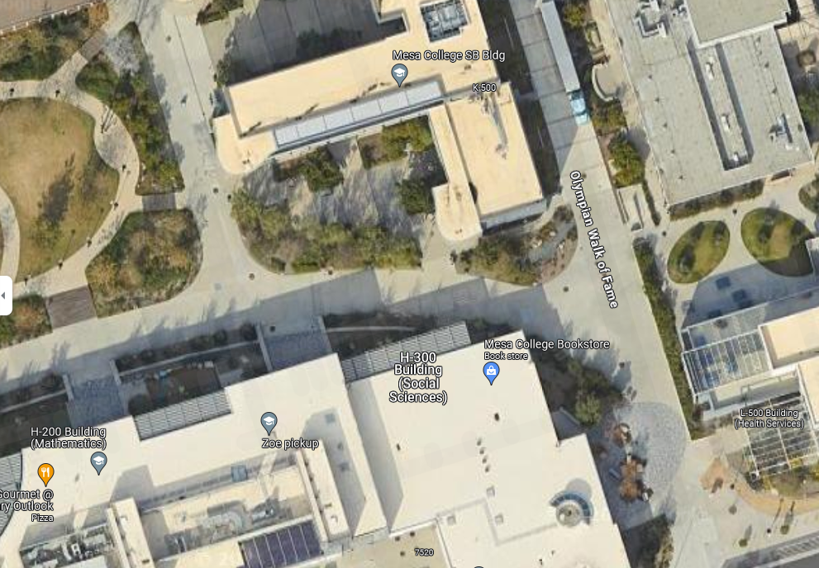


Event Name
Date
Total Resources:
(#) 10x10 Canopies
(#) 5-ft Tables
(#) Chairs
(#) ea. Trash/Recycling Bins
Key:
Table
Chairs
10 x 10

