Slide 1


Slide 2

Since 2015, San Diego Mesa College has dedicated resources (financial, personnel, and space) to addressing basic needs insecurity of our students. As a campus we are committed to creating conditions that matter.
The belief being that our students will be more successful in their courses if they are not worrying about how to get textbooks, when they might be able to eat, where they might be able to get food, how they will fill their gas tank, get a bus pass, take a shower, or sleep safely at night.
The Office of Student Success and Equity has led the way with intentionally addressing the fundamental right of students to have their basic needs met through a variety of programmatic planning, specifically with the creation of direct student support, a food pantry, a professional clothing closet and community partnerships.
We are proud to have established The Stand Basic Needs Resource Center
Basic Needs as a Fundamental Right

Slide 3

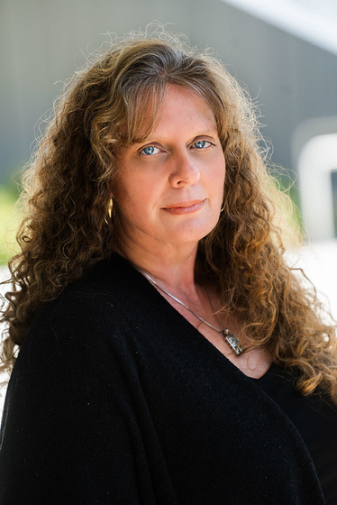
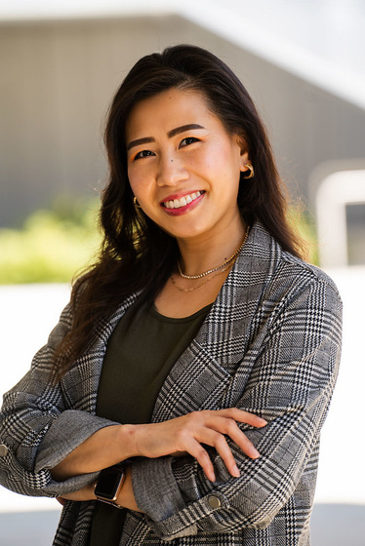

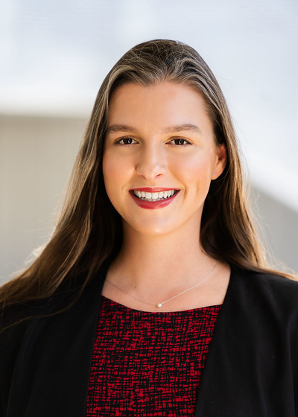
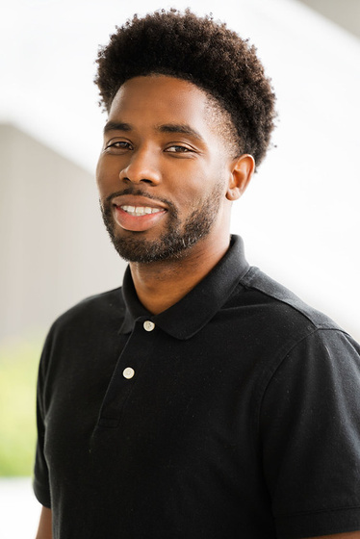
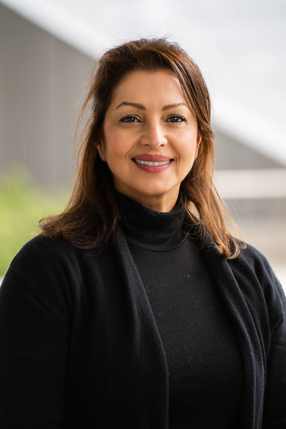
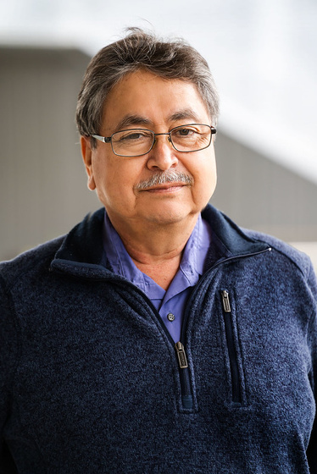
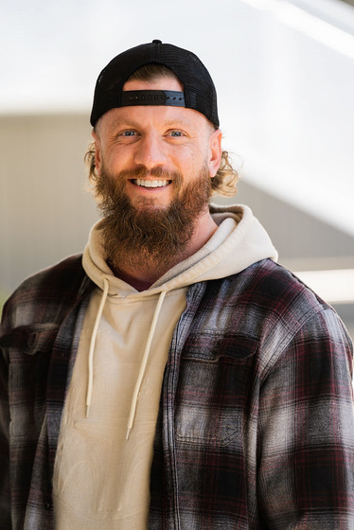
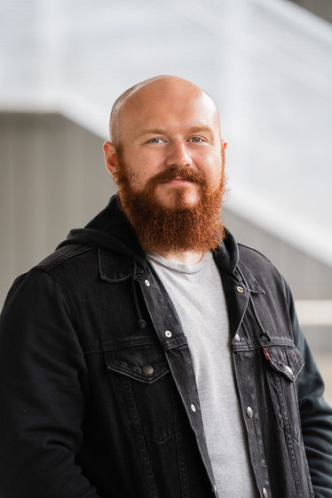
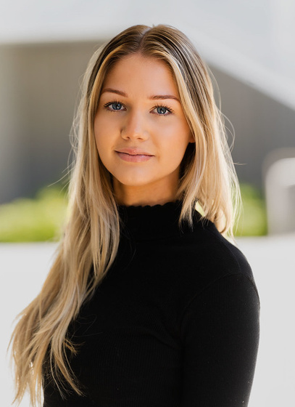
The Stand

Slide 4



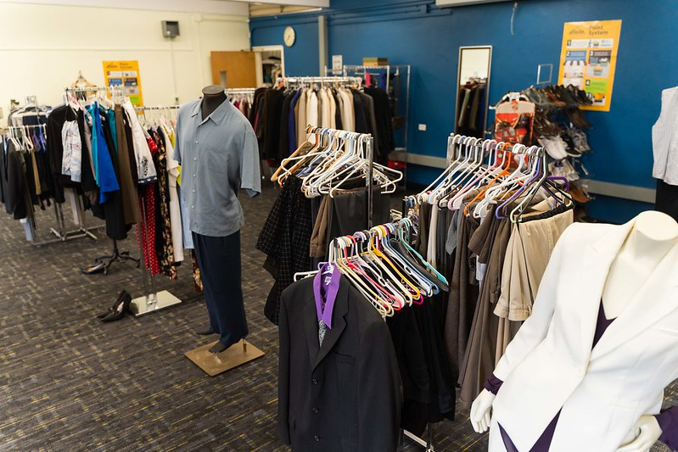
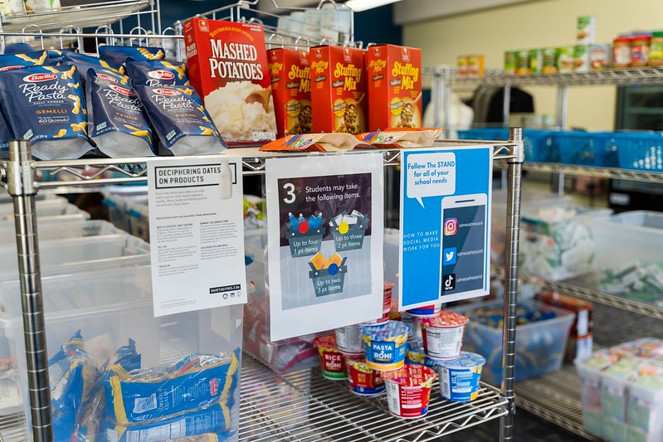
Emergency Food Pantry
Located in K106
Students are awarded 100 points per semester which is roughly 16 points per week.
Food pantry items range from granola bars, nuts, frozen meals, beverages, soups and much more.
Student can get up to 8 articles of clothing per semester

Slide 5
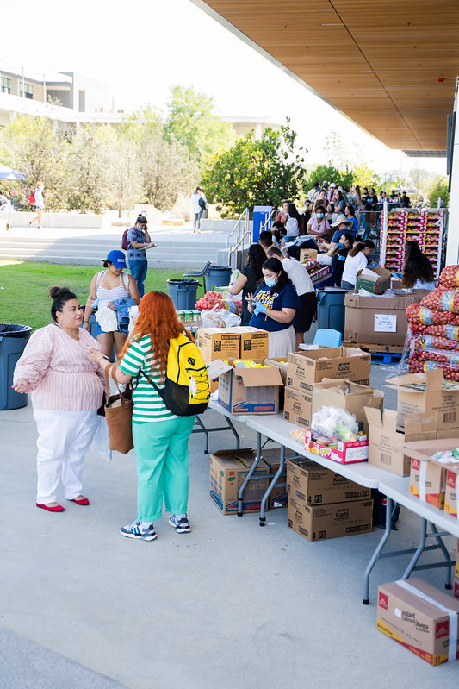
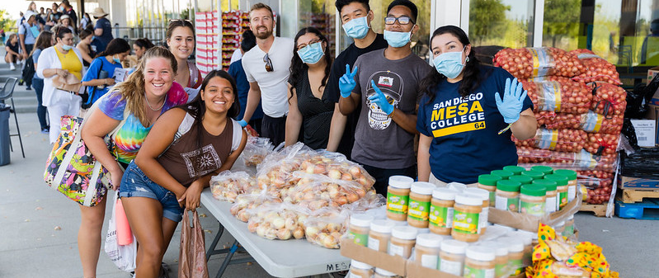

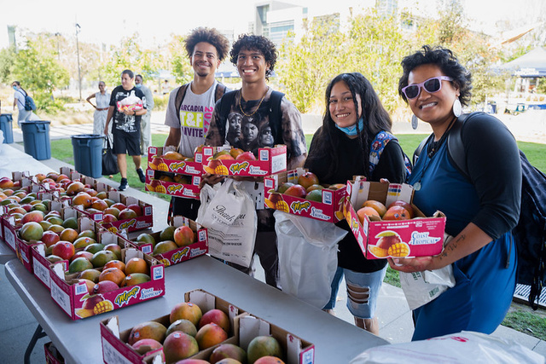
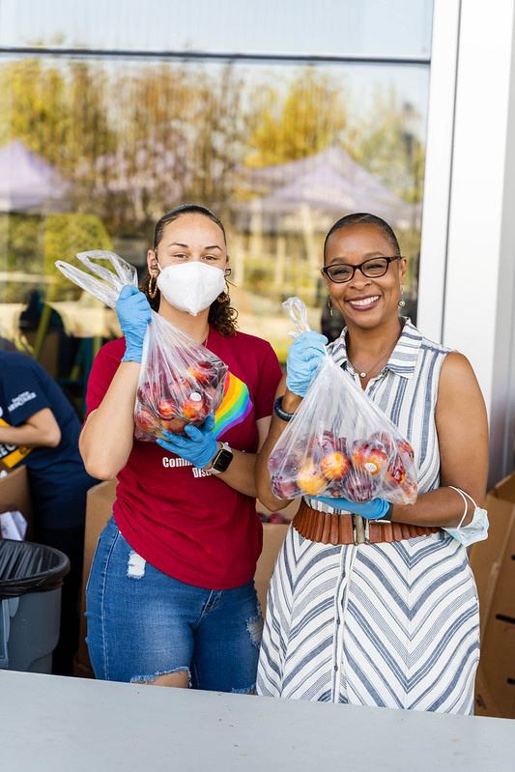
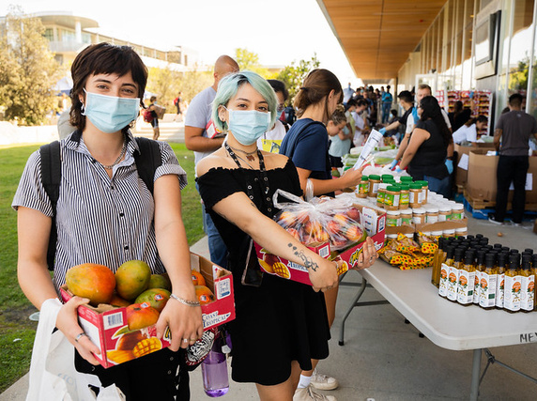
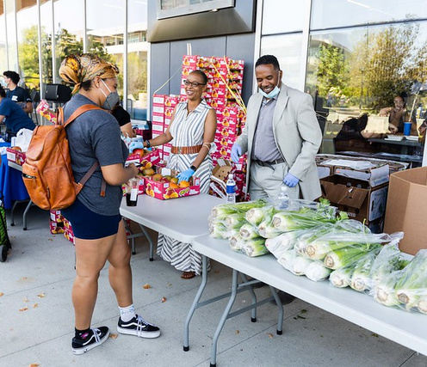
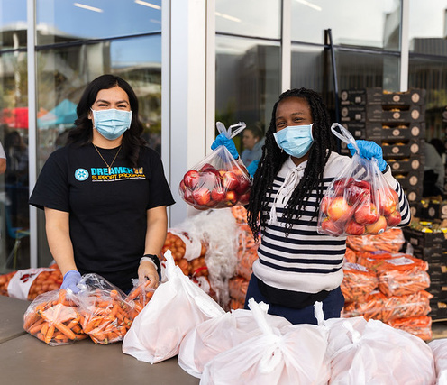
Food Distributions
1st Monday of the month 1pm to 2pm
3rd Thursday of the month 11am to 1pm
Located in the Quad/ MC Breezeway

Slide 6
Direct Student Support
Food
Transportation
Mental Health
Childcare
Food Distributions, CalFresh, grocery cards, SD Food Bank
We provide gas cards, bus passes, or Uber cards if needed.
We give mental health referrals to on campus counseling
We give referrals to the CDC if applicable.
Housing Support
Technology
Physical Health/Toiletries
Assist students finding resources for housing
Students get book support, school supplies, regalia
We give physical health referrals

Slide 7




Emergency Aid
Students can potentially be awarded up to $500, depending on their case.
Emergency Aid includes medical emergencies, unexpected car repair, unexpected change in housing, expenses due to death in the family.
Student must provide adequate documentation of unforeseen circumstance.

Slide 8

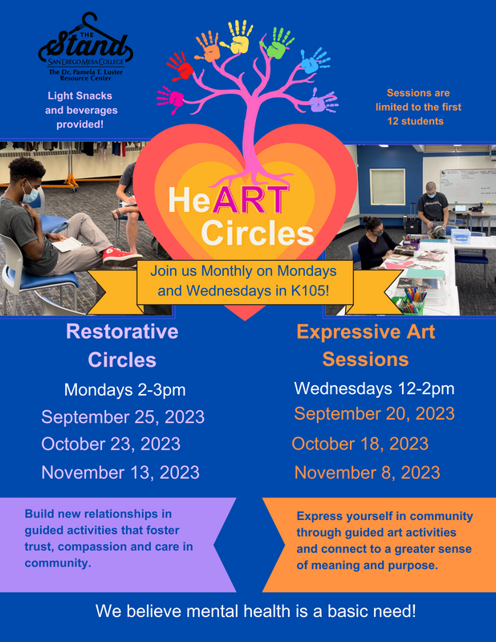


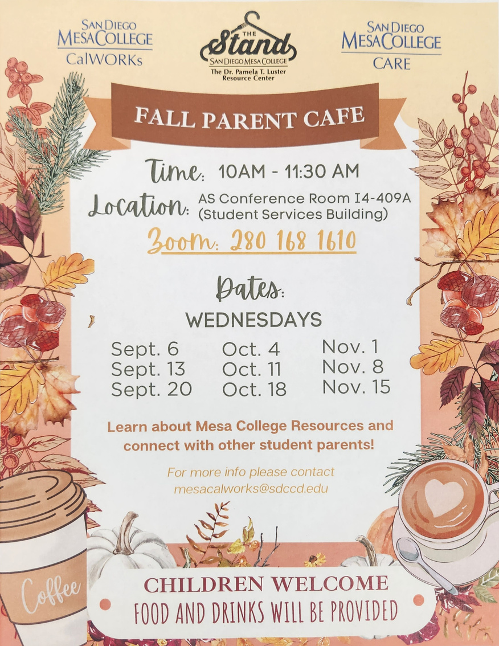
Workshops

Slide 9

Cal Fresh
Calfresh is a state program that awards students up to $193 a month for groceries.
Students EBT cards can be used at supermarkets, convenience stores and farmer’s markets.
To apply to Calfresh
https://www.getcalfresh.org/students1-877-847-3663
If you need help we have Cal Fresh Ambassadors to assist with the process or you can go to Feeding San Diego's website.

Slide 10
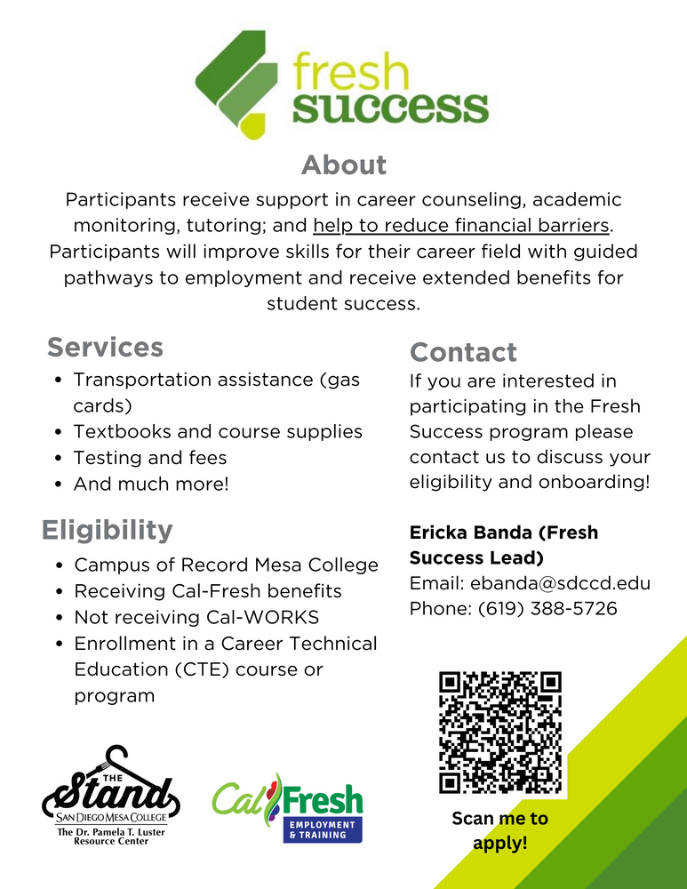
Fresh Success
“Helping low-income Californians succeed in the workforce.”
The Stand has partnered with the foundation of California Community Colleges to implement Fresh Success Program starting Fall 2023
Program benefits include improved skills for students who are unemployed or low-wage workers, extends benefits to students regardless of their enrollment status, provides employment pathway for low income students.
The Stand has partnered with ECMC to provide support to students dealing with unforeseen financial emergencies.
Must be enrolled in classes and have higher than a 2.0 cumulative GPA.

Slide 11



Housing Support
Figuring out a budget needed for rent and utilities.
Finding a specific location to move to.
What websites to look at for apartments. What to look for in apartments/ what amenities you might need.
Where to look and find roommates. What questions to ask them before moving in together.
Give students referrals to shelters, transitional housing, and safe parking locations.

Slide 12

Housing Partnerships
Youth Assistance Coalition
Urban Street Angels
The LGBT Center
South Bay Community Services
YMCA TAY Youth
211
San Diego
Roomchazers
Off Campus
Housing

Slide 13
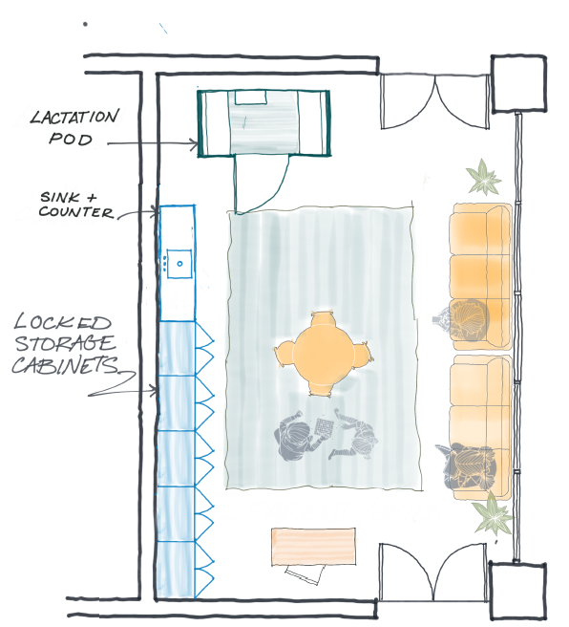
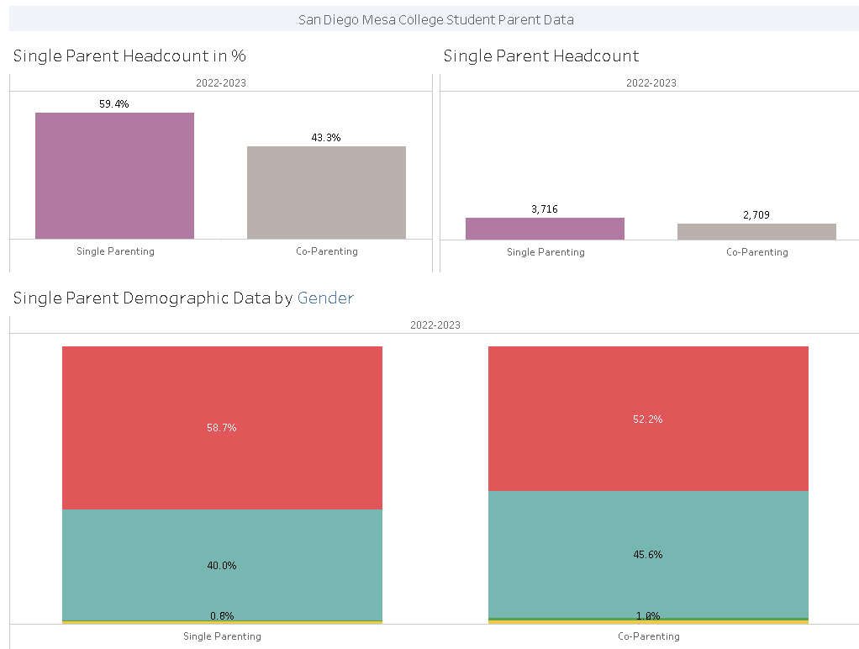

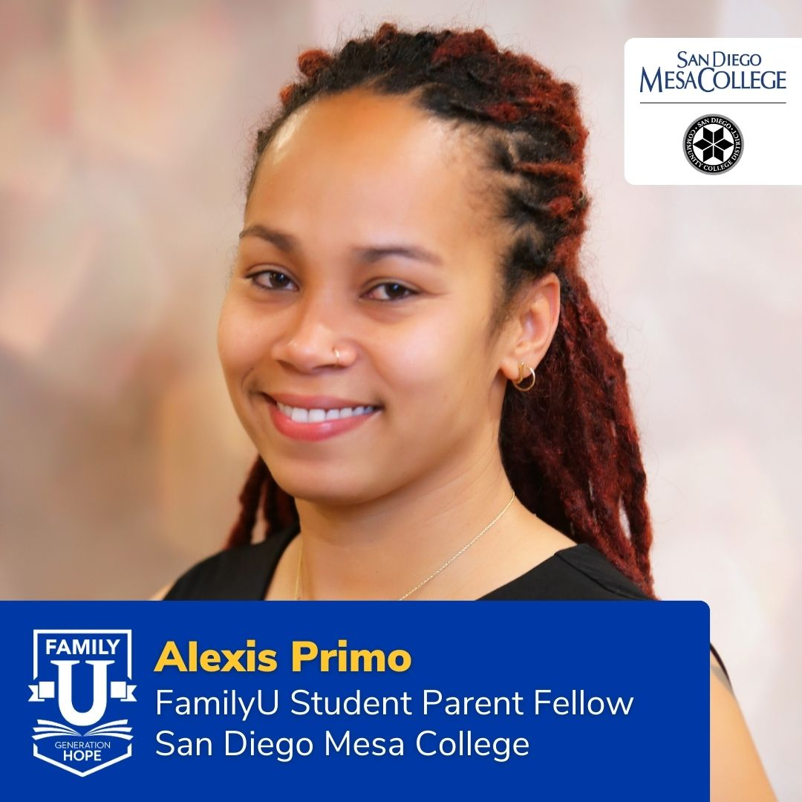
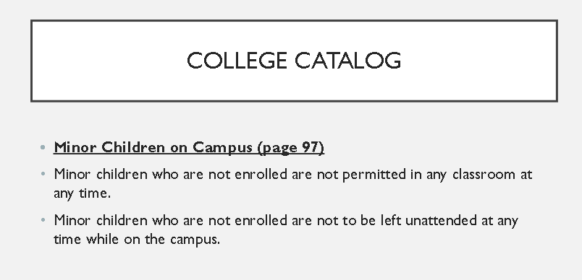
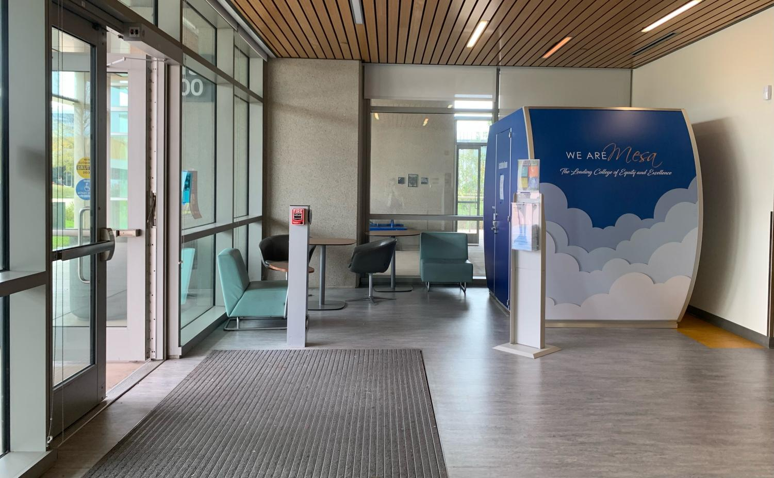
Family U Work
Family U 2 year Cohort
Data – Campus and CCCApply
Policy - Information
People – Student Parent Fellow, Taskforce, Ally List
Culture – Places and Spaces
Notes:
The Campus applied and was accepted to the second cohort of Generation Hope’s Family U program. The work the campus team under the leadership of The Stand have fallen into 4 main areas.
Data: CCCApply ask new students about parenting status, SDCCD has a required popup in the student portal with parenting questions
Policy: District has 2 written policies regarding children on campus and Title IX provides protection for pregnant and lactating students
People: Two programs have been on campus for awhile, primarily servinf single parents; CalWorks and CARE. The Family U Team made up of 6 campus leaders include our student parent fellow. We have created a taskforce that reports to the dean of SSE Leticia Diaz. Our Student Fellow is creating an ally list for the campus of faculty, classified professionals, and administrators who are compassionate to the unique needs of student parents
Culture: Mamava Lactation Pods; you will begin seeing areas around campus with child size furniture and activities (high chairs in MC, public area space in I400, etc) ; Family Resource Room opening soon (Spring 2024)

Slide 14
How Can I Help?
•Be informed of and promote campus. departments and events.
•Consider donating to The Stand.
•Participate in events.
•Refer Students to Basic Needs Department.
•Currently located in k106/k105
•Email: mesathestand@sdccd.edu
•Call: (619)-388-5726
•Follow us on Twitter, Instagram, and Tik Tok: @SDMesaTheStand

Slide 15

Questions...

